Slide 1

Infosys Springboard Internship 5.0
PROJECT NAME
Voice-Based Patient Call System
MENTOR: SHILPIE

Slide 2
Project Overview
This project is a healthcare management system designed to connect patients and nurses efficiently.
Key features:
Patients can request medical help through an app.
Nurses can manage requests and respond in real time.
AI ensures critical requests are handled first.
1. Team Details
Team Name: [Enter your team name here]
Team Members:
[Name of first team member]
[Name of second team member (if any)]
[Name of third team member (if any)]
[Name of fourth team member (if any)]

Slide 3



Problem Statement
1. Team Details
Team Name: [Enter your team name here]
Team Members:
[Name of first team member]
[Name of second team member (if any)]
[Name of third team member (if any)]
[Name of fourth team member (if any)]
Current Challenge
Delayed communication in hospitals affects patient care quality.
Gap
No system prioritizes patient needs dynamically or assists with multilingual support.
.
Solution
A centralized app that bridges the gap between patients and nurses using smart technology..

Slide 4
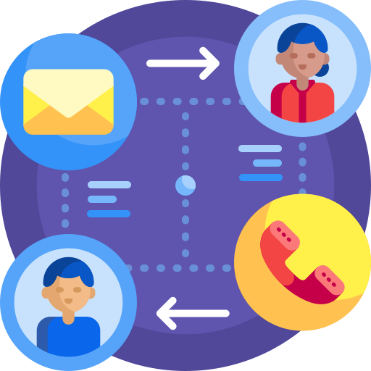

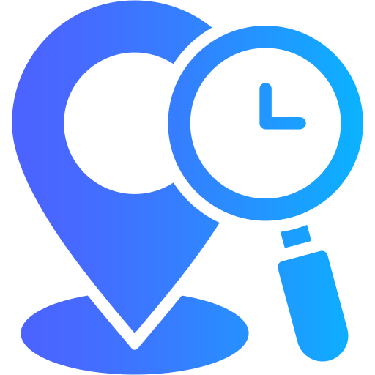

Objectives
1. Team Details
Team Name: [Enter your team name here]
Team Members:
[Name of first team member]
[Name of second team member (if any)]
[Name of third team member (if any)]
[Name of fourth team member (if any)]
Provide a simple and fast communication channel between patients and nurses.
Use AI to prioritize critical medical needs.
Enable real-time tracking and notifications for nurses..
Offer a multilingual AI assistant for basic health guidance..

Slide 5






Technology Stack
Frontend: Expo React Native for mobile app development.
Backend: Node.js and Express for API and server logic.
Database: MongoDB for data storage.
AI Models: TensorFlow.js with Universal Sentence Encoder for
request prioritization.
APIs: Gemini API for the AI assistant.
Real-Time Communication: Socket.IO for notifications.
1. Team Details
Team Name: [Enter your team name here]
Team Members:
[Name of first team member]
[Name of second team member (if any)]
[Name of third team member (if any)]
[Name of fourth team member (if any)]

Slide 6
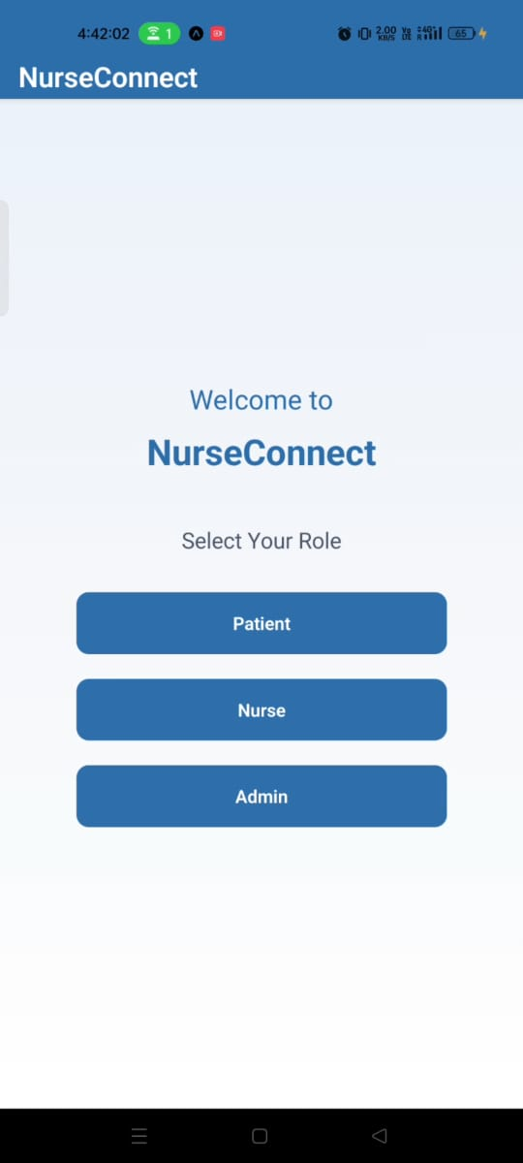
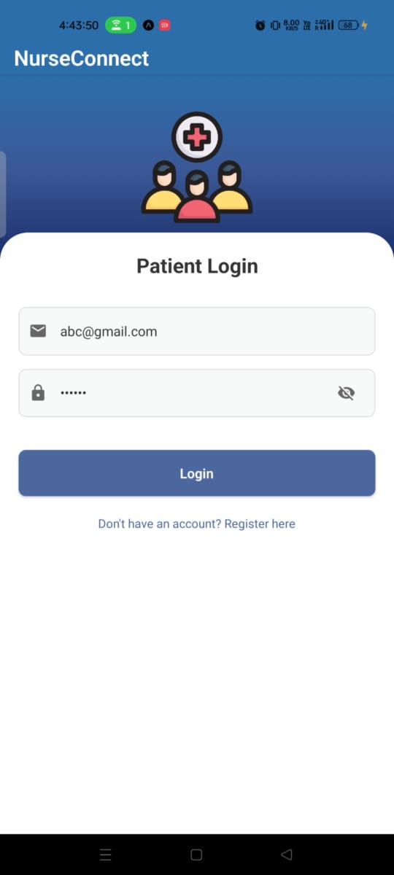
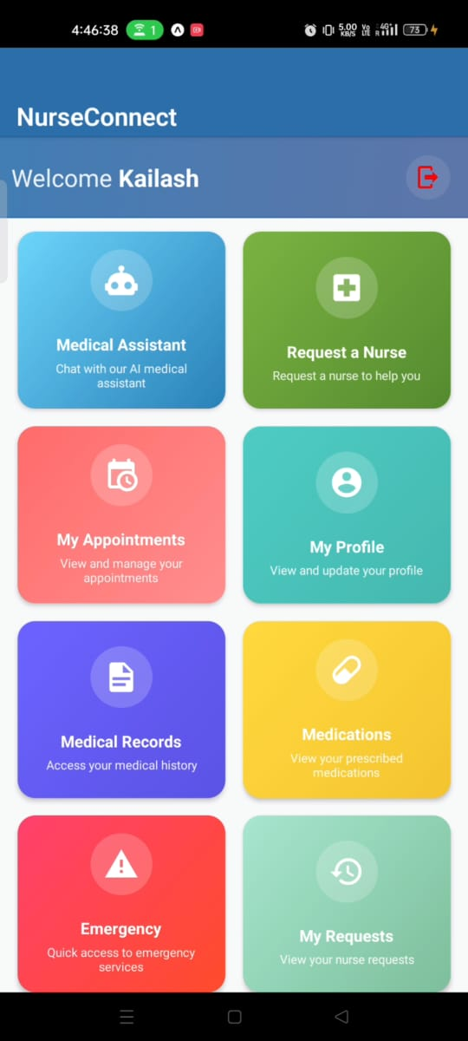
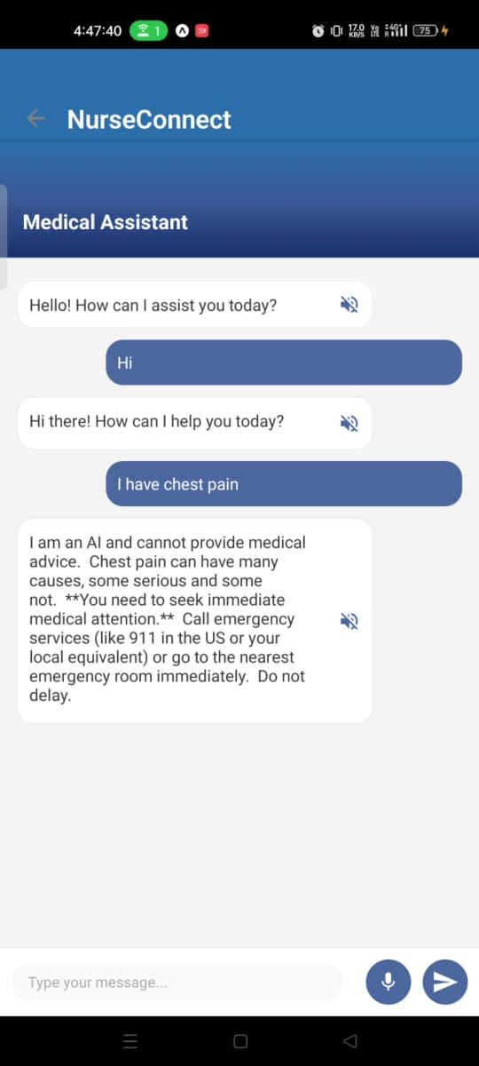
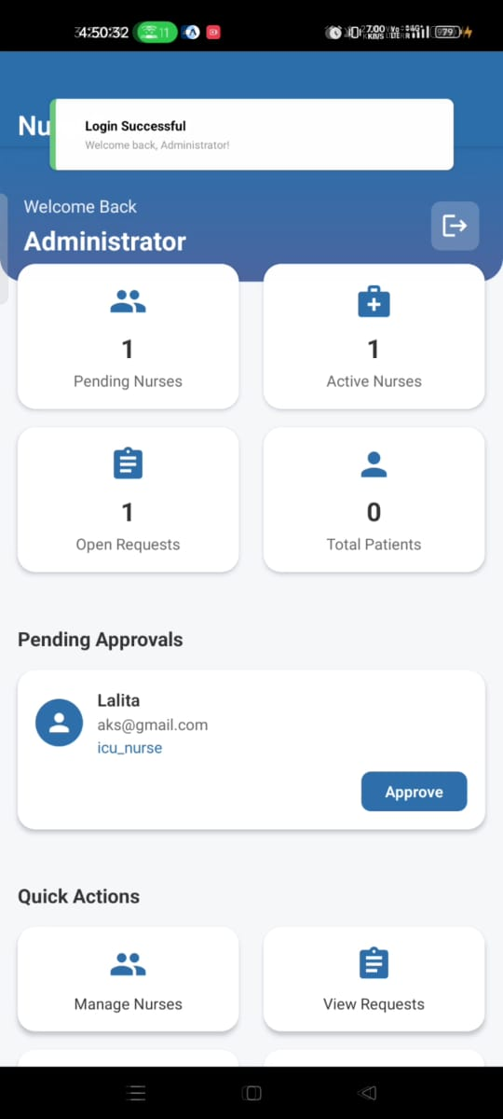
App Screenshots
1. Team Details
Team Name: [Enter your team name here]
Team Members:
[Name of first team member]
[Name of second team member (if any)]
[Name of third team member (if any)]
[Name of fourth team member (if any)]

Slide 7
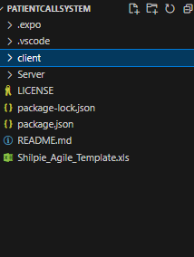
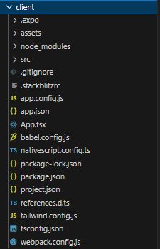
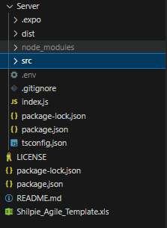
Project Directory Structure
Client: Frontend code (React Native) Server: Backend logic (Node.js, Exp.).
1. Team Details
Team Name: [Enter your team name here]
Team Members:
[Name of first team member]
[Name of second team member (if any)]
[Name of third team member (if any)]
[Name of fourth team member (if any)]

Slide 8
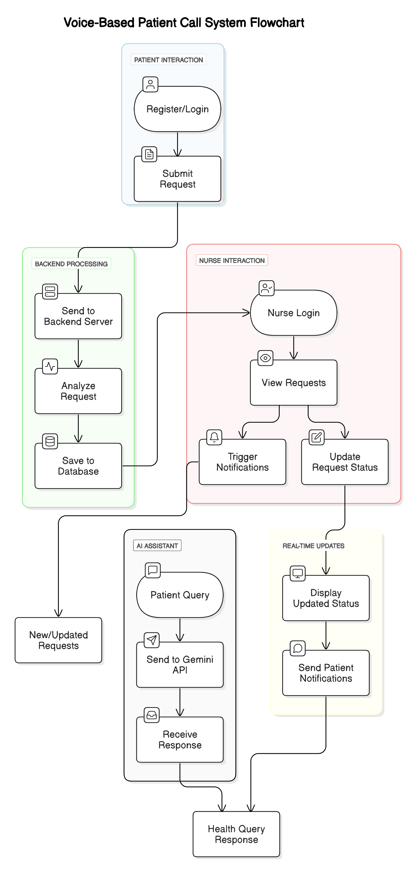
Flowchart
1. Team Details
Team Name: [Enter your team name here]
Team Members:
[Name of first team member]
[Name of second team member (if any)]
[Name of third team member (if any)]
[Name of fourth team member (if any)]

Slide 9
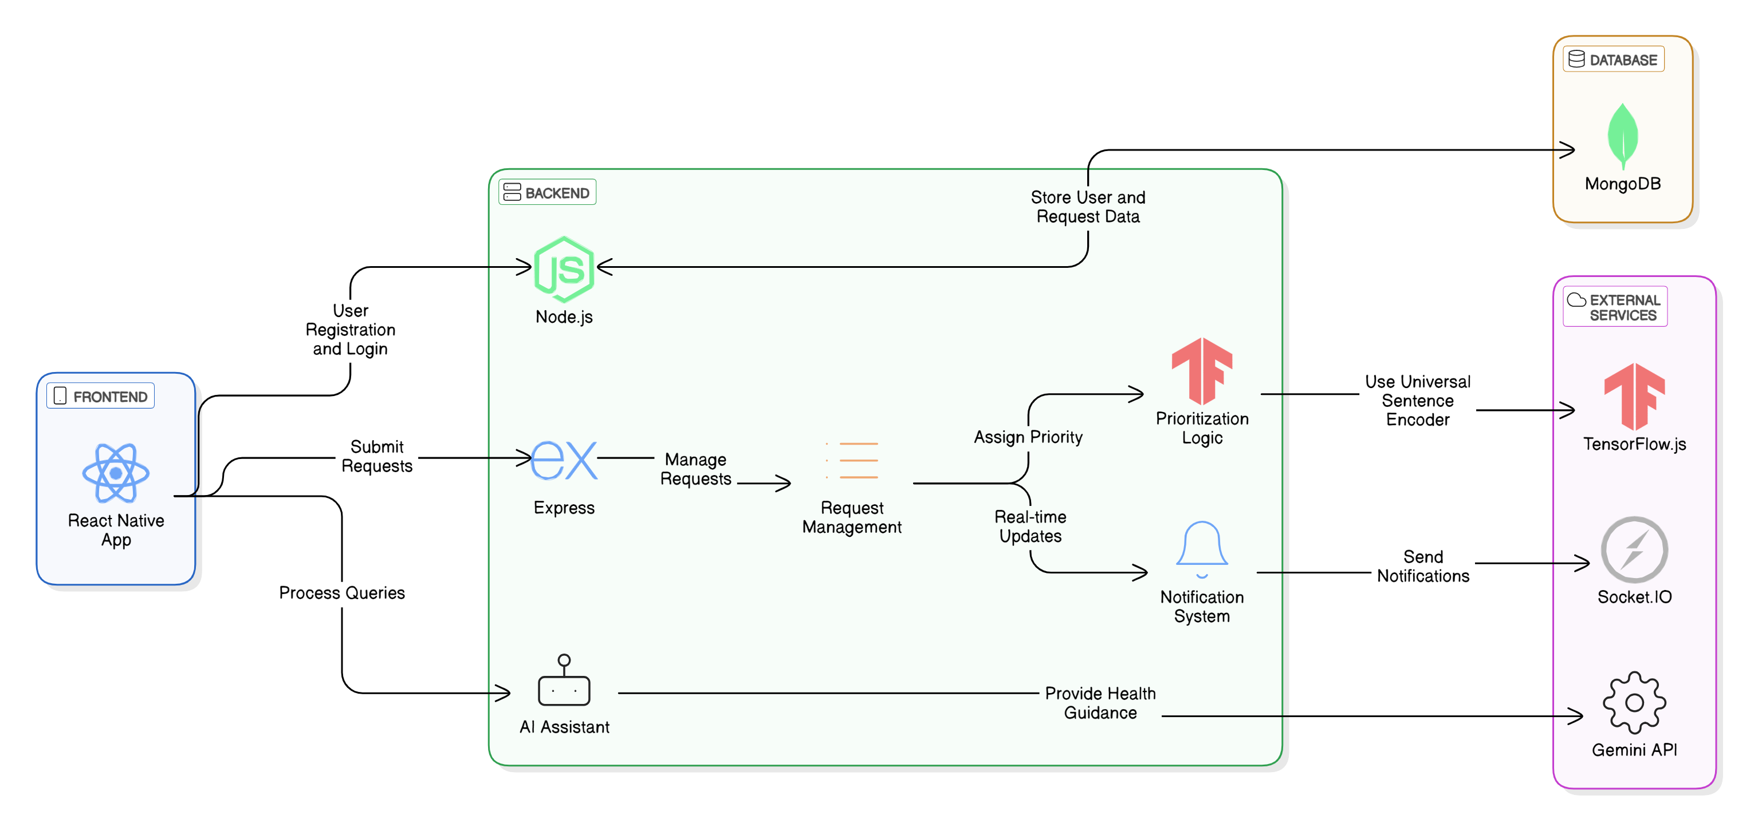
System Diagram
1. Team Details
Team Name: [Enter your team name here]
Team Members:
[Name of first team member]
[Name of second team member (if any)]
[Name of third team member (if any)]
[Name of fourth team member (if any)]

Slide 10
Key Features
Secure User Authentication : Uses hashed passwords and JWT for safety.
Dynamic Request Prioritization: AI ranks requests as Critical, High, Medium, or Low.
Real-Time Notifications: Nurses receive updates instantly.
Multilingual AI Assistant: Answers patient queries in English and Hindi.
Role-Based Access: Admins, nurses, and patients have different permissions.
1. Team Details
Team Name: [Enter your team name here]
Team Members:
[Name of first team member]
[Name of second team member (if any)]
[Name of third team member (if any)]
[Name of fourth team member (if any)]

Slide 11
Future Scope
Real-Time Chat and Voice Communication:
Add direct messaging and voice calls between patients and nurses.
Voice Assistant Support
Implement voice-based commands for patients who cannot type..
IoT Device Integration:
Connect medical devices to the app for real-time health monitoring.
Regional Language Expansion Support for more Indian languages to improve accessibility.
Integration with Government Schemes
Collaborate with healthcare programs for wider reach and impact.
1. Team Details
Team Name: [Enter your team name here]
Team Members:
[Name of first team member]
[Name of second team member (if any)]
[Name of third team member (if any)]
[Name of fourth team member (if any)]

Slide 12
Uniqueness
Comprehensive Role-Based Design : Separate modules for patients, nurses, and admins with role-specific functionality, ensuring tailored user experience.
Real-Time Communication : Integrated socket service enables instant updates and seamless communication for critical patient requests.
User Authentication & Role Management : Supports secure login, registration, and role-based access control for patients, nurses, and administrators.
Rich User Interface : Designed with multiple interactive dashboards and intuitive screens, enhancing usability and engagement.
Scalable API Integration : Modular backend APIs for authentication, appointment management, and requests ensure scalability.
Modern Tech Stack : Built using TypeScript, Tailwind CSS, and Native Script, ensuring type safety, responsive UI, and cross-platform compatibility.
Expandable & Modular : Clean architecture with reusable components and services, making it easy to add new features.
1. Team Details
Team Name: [Enter your team name here]
Team Members:
[Name of first team member]
[Name of second team member (if any)]
[Name of third team member (if any)]
[Name of fourth team member (if any)]

Slide 13
Thank You

